Slide 1
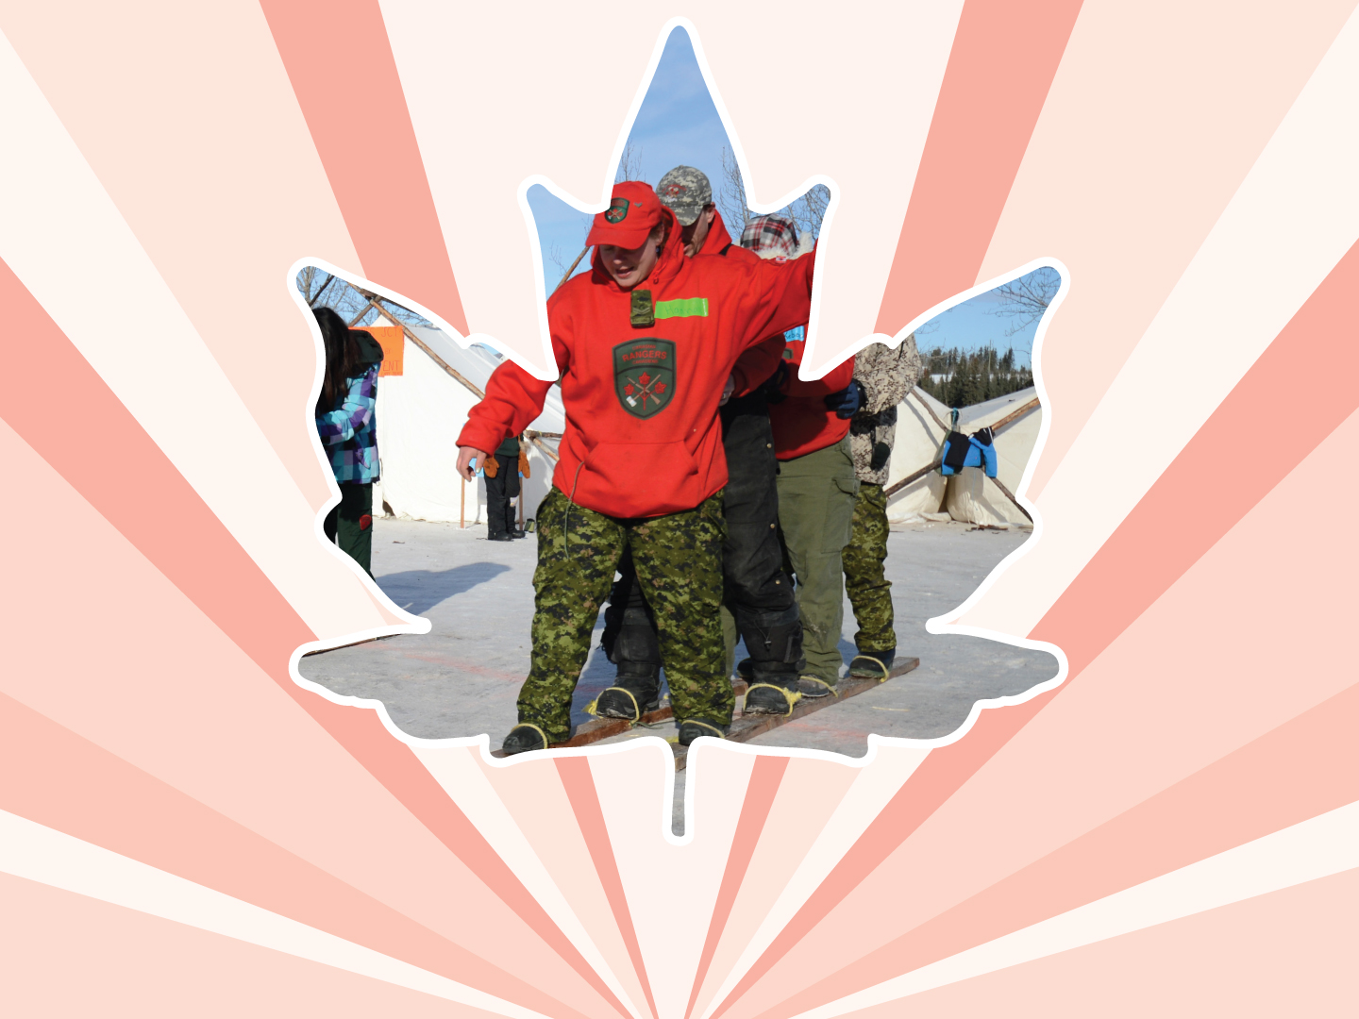
Lesson 8
Consent and sexual assault
Ages 15–18

Slide 2

WHAT IS consent?
“Consent” is a voluntary,
non-coerced agreement
to engage in sexual activity.
2 / 11
Notes:
Canadian Red Cross. (2006). Healthy youth relationships: An educational workshop for adults.

Slide 3



Consent is…
Consent is affirmative and enthusiastic.
It is a positive, enthusiastic response: someone is saying, “Yes!”
Consent is freely given and non-coerced.
We give consent because we want to, not because we are pressured to do so by others.
3 / 11

Slide 4
Consent is…
Consent is ongoing.
Consent is not something that is given once and then assumed afterwards. We must get consent and give consent before any type of sexual activity can happen.
Consent is 100% reversible.
We have the right to change our mind at any time and withdraw our consent.
Consent is clear-headed.
We must be conscious and sober to give consent.
4 / 11

Slide 5
AGE OF CONSENT (PROTECTION)
16
The “age of consent” is the age when it is legal for a youth to consent to sexual activity.
The “age of consent” is also called the “age of protection” because the laws are meant to protect children and youth from being abused by someone who is older or by someone who has more power.
5 / 11

Slide 6
AGE OF CONSENT (PROTECTION)
16
In general, the age of consent in Canada is 16 years old.
In certain relationships, the age of consent in Canada is 18 years old.
No person can engage in sexual activity with a child under 12 years old, under any circumstance. Children under the age of 12 CANNOT consent to sexual activity.
6 / 11

Slide 7
WHEN CONSENT IS NOT POSSIBLE
Someone tries to say yes for you, e.g., “Your boyfriend / girlfriend said you would have sex with me.”
Someone abuses a position of trust or authority to get another person to have sex with them. That person can be a:
  babysitter;
  teacher;
  coach;
  another cadet or JCR;
  corps / squadron / patrol staff.
7 / 11

Slide 8
WHEN CONSENT IS NOT POSSIBLE
Someone threatens you or uses force.
Someone says no, or does not say yes.
Someone expresses no through body language or actions.
Someone is sleeping, unconscious, intoxicated or high.
Cadets and JCRs may be in positions of authority over other cadets and JCRs, and in these circumstances, consent cannot be given.
8 / 11

Slide 9
Protection from Exploitation and Abuse of Power
For all youth aged 12–17, consent is not possible if the other person is:
in a position of trust or authority over the child:
    babysitter;
    teacher;
    coach;
someone on whom the youth is dependent; or
in an exploitative relationship with the child or youth.
    another cadet or JCR;
    corps/squadron/patrol staff.
Sexual activity in the context of the above relationships is illegal.
Only a person aged 18 or older is capable of consent in these situations.
Cadets and JCRs may be in positions of authority over other cadets and JCRs, and in these circumstances, consent cannot be given.
9 / 11

Slide 10
Close-in-Age Exemptions
If the person is not in a position of trust or authority over the child or youth, if the child or youth is not dependent on the person, and if the person is not in an exploitative relationship with the child or youth, then these rules apply:
A 12- or 13-year-old can consent to sexual activity if the partner is less than two years older.
A 14- or 15-year-old can consent to sexual activity if the partner is less than five years older.
A 16- or 17-year-old can consent to sexual activity if the partner is old enough to consent with them.
10 / 11
Notes:
Public Legal Education and Information Service of New Brunswick. (2013). No means no: Understanding consent to sexual activity.

Slide 11
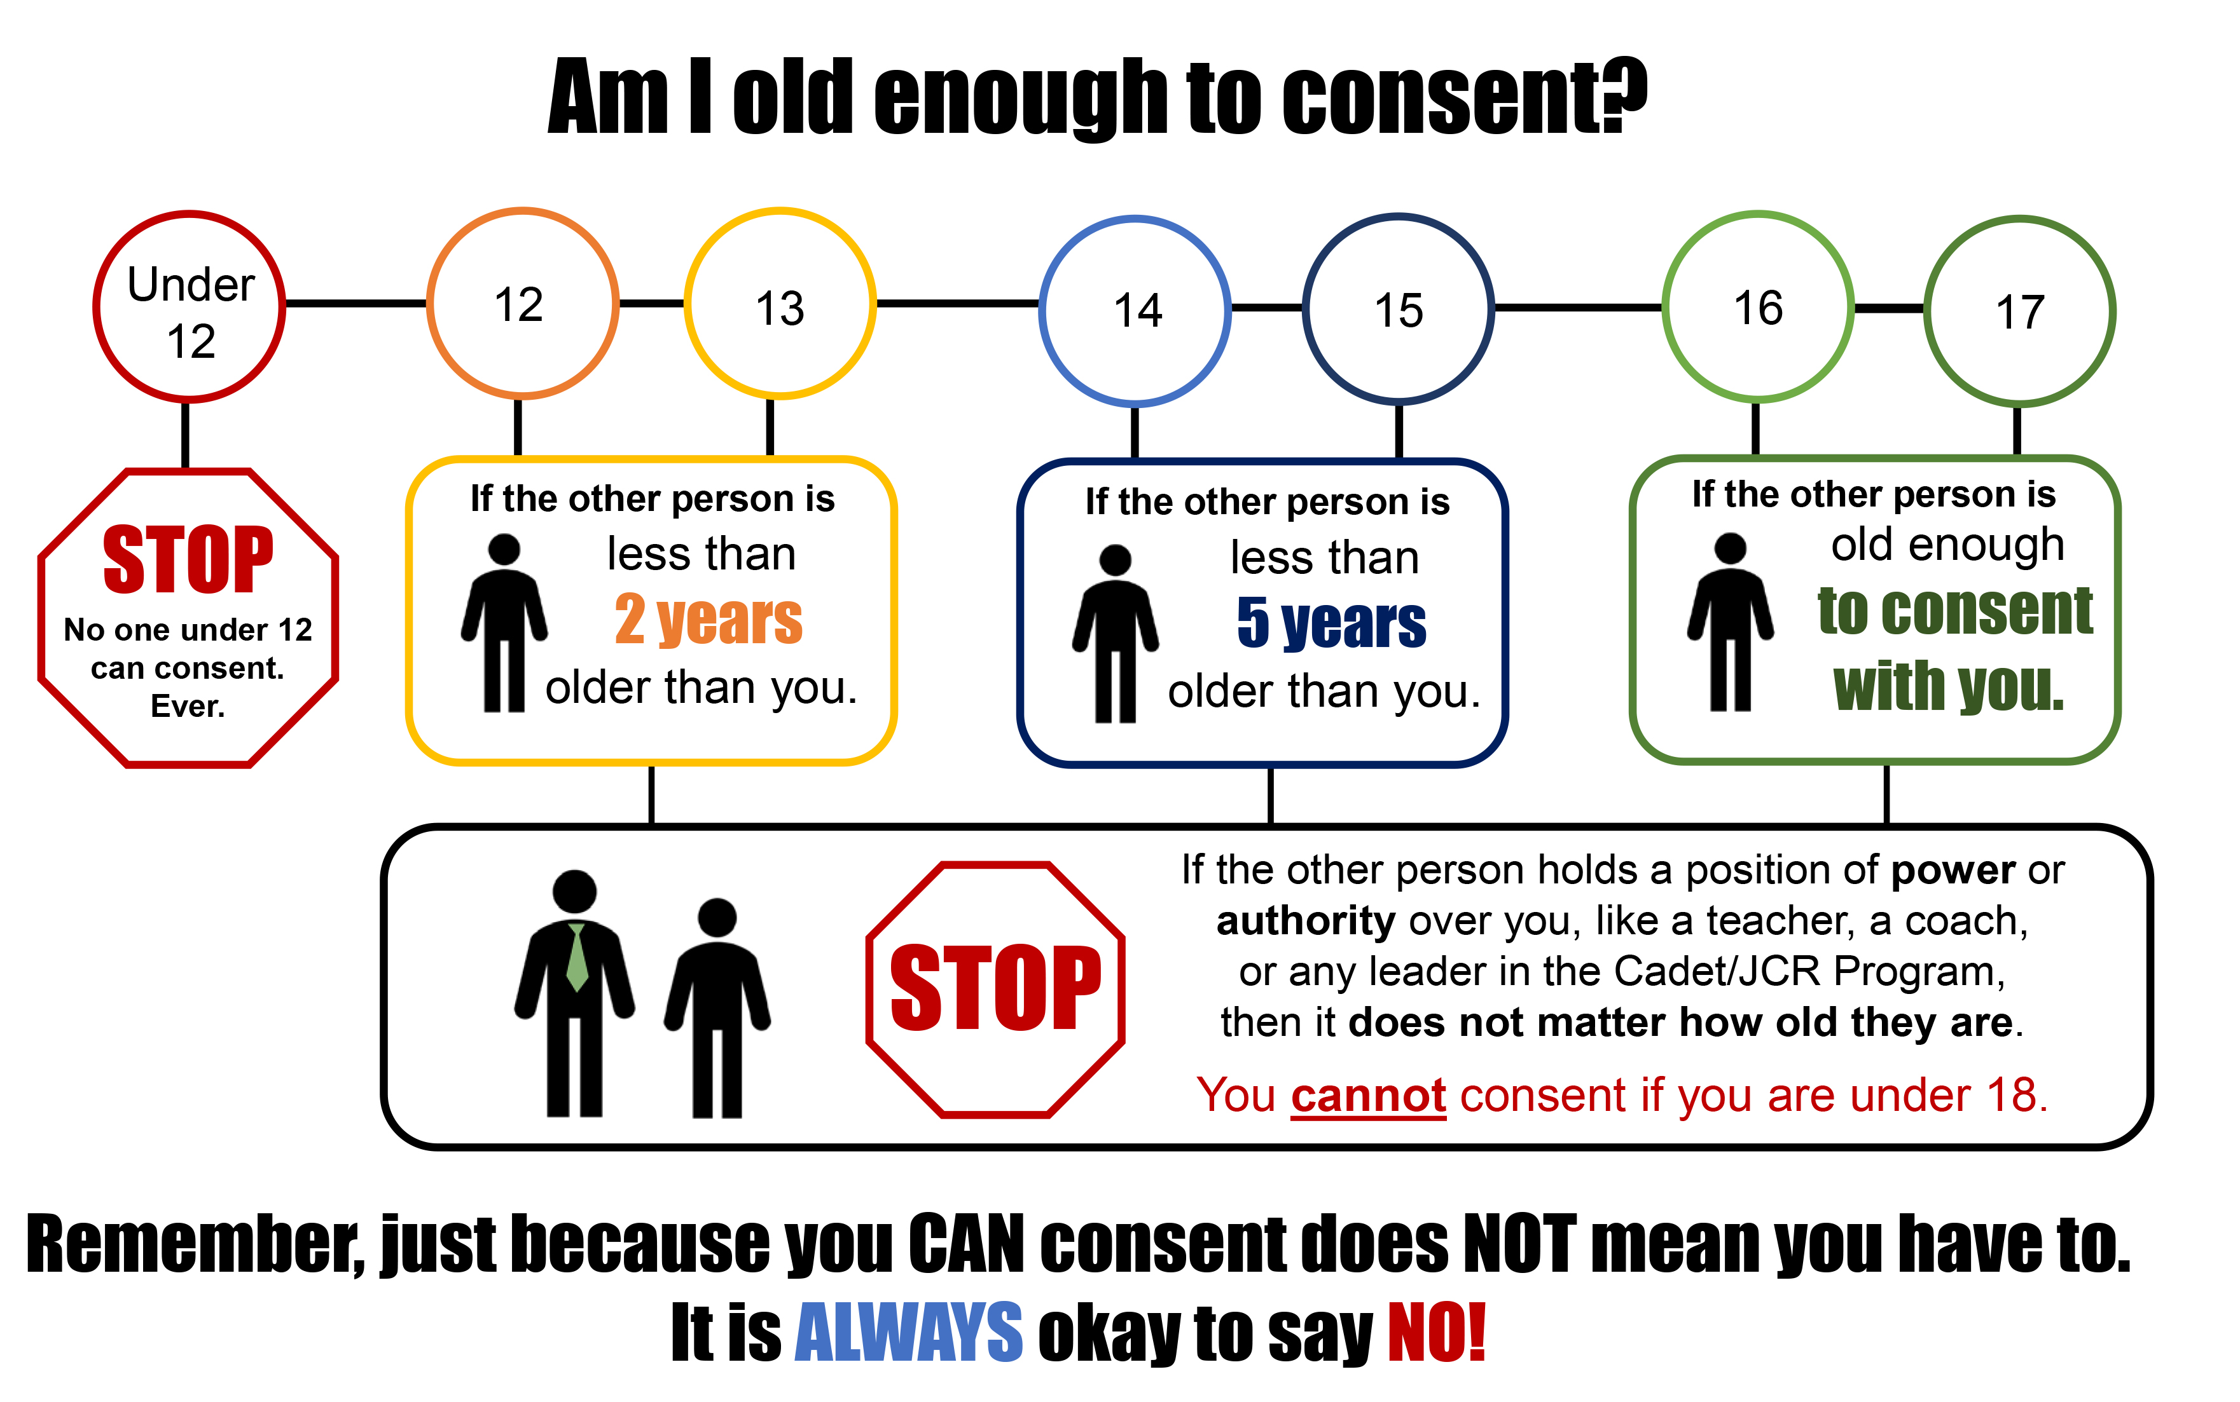
11 / 11

Slide 12




LINK
LOOK
LISTEN
LIVE
1 / 5
Notes:
Copyright © 2020 The Canadian Red Cross Society
LOOK: Are they acting different than before? Are they: sad, anxious, angry, and alone all the time, drinking and using drugs, taking big risks, hurting themselves or others.
We need to be looking out for each other and checking in with teammates and friends.

Slide 13
STEP 1: LOOK
Sad
Angry
Taking big risks
Hurting themselves or others
Using drugs and alcohol
Anxious
Alone
2 / 5
Notes:
Copyright © 2020 The Canadian Red Cross Society
LOOK: Are they acting different than before? Are they: sad, anxious, angry, and alone all the time, drinking and using drugs, taking big risks, hurting themselves or others.
We need to be looking out for each other and checking in with teammates and friends.

Slide 14
STEP 2: LISTEN
Are you okay?
Can I help?
Be calm
Be open
Listen without judgment
3 / 5
Notes:
Copyright © 2020 The Canadian Red Cross Society
LOOK: Are they acting different than before? Are they: sad, anxious, angry, and alone all the time, drinking and using drugs, taking big risks, hurting themselves or others.
We need to be looking out for each other and checking in with teammates and friends.

Slide 15
STEP 3: LINK
Cadet / JCR Leaders
Parents / Caregivers
Counsellors /
Teachers
Friends
Kids Help Phone
4 / 5
Notes:
Then we need to link them to people and/or resources.
LINK: Let them know there are people who can help. Encourage them to talk to a trusted adult or offer to go with them to talk to someone who can help. Let them know, “I want you to be safe; we need to get help.”
Copyright © 2020 The Canadian Red Cross Society
LOOK: Are they acting different than before? Are they: sad, anxious, angry, and alone all the time, drinking and using drugs, taking big risks, hurting themselves or others.
We need to be looking out for each other and checking in with teammates and friends.

Slide 16
STEP 4: LIVE
Journal
Sports / Exercise
Eat healthy
Music
Bead /
Sew /
Draw / Poetry
Time with animals
Hunt / Hike / Nature
Video / Movie theatre
Socialize
Talk to family and friends
5 / 5
Notes:
We want to ensure you are using healthy coping mechanism to deal with your stress.
What are some healthy ways to deal with stress? Have the players brainstorm a list then read out the ones on the PP.
Copyright © 2020 The Canadian Red Cross Society
LOOK: Are they acting different than before? Are they: sad, anxious, angry, and alone all the time, drinking and using drugs, taking big risks, hurting themselves or others.
We need to be looking out for each other and checking in with teammates and friends.

Slide 17





KIDS HELP PHONE
If you need one-on-one time with someone who gets what is going on in your life, you can connect anonymously with Kids Help Phone. Our counsellors are available 24 hours a day, seven days a week to support you with whatever you are going through.
CALL 1-800-668-6868 to talk with a counsellor
CHAT with a counsellor at KidsHelpPhone.ca or through the Always There App
TEXT 686868 to connect with a trained volunteer Crisis Responder
1 / 2

Slide 18
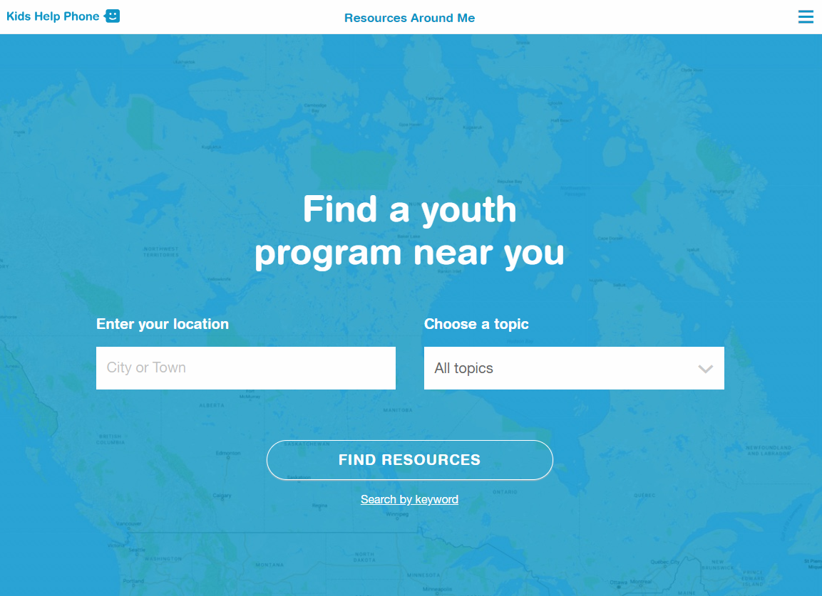
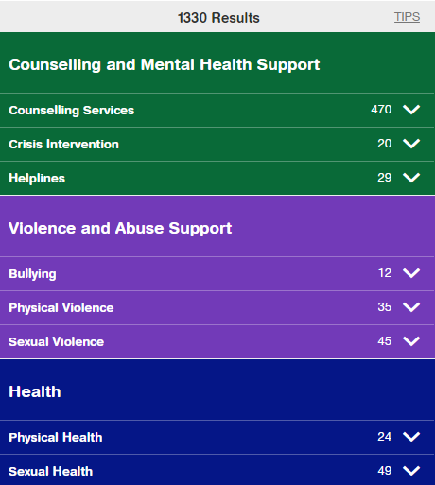
RESOURCES AROUND ME
Resources Around Me is a free, interactive tool, available in English and French, through Kids Help Phone’s website.
The tool helps young people to independently connect to local programs and services in their communities.
These services include:
  Counseling and mental health
  Sexual health
  Housing help
  Legal help
  LGBTQ2S services
  Youth shelters
kidshelpphone.ca/resourcesaroundme
2 / 2

Slide 19
Community Resources
Add local resources to this slide
1 / 1

