Slide 1
Lesson 2
Dating Relationships
Ages 15–18
Notes:
Canadian Red Cross. (1997). Hearing the hurt, changing the future: Abuse prevention services for youth.

Slide 2
dating violence Statistics:
A study showed Canadian youth aged 15 to 24 have the highest risk of experiencing dating violence in their relationships.
In the same study, 27 percent of youth reported that their girlfriend / boyfriend / partner checked up on them via text 10 or more times per hour.
An online survey of youth aged 11 to 14 revealed that 62 percent knew friends who were called “stupid” and “ugly” by their boyfriend / girlfriend / partner.
2 / 5

Slide 3
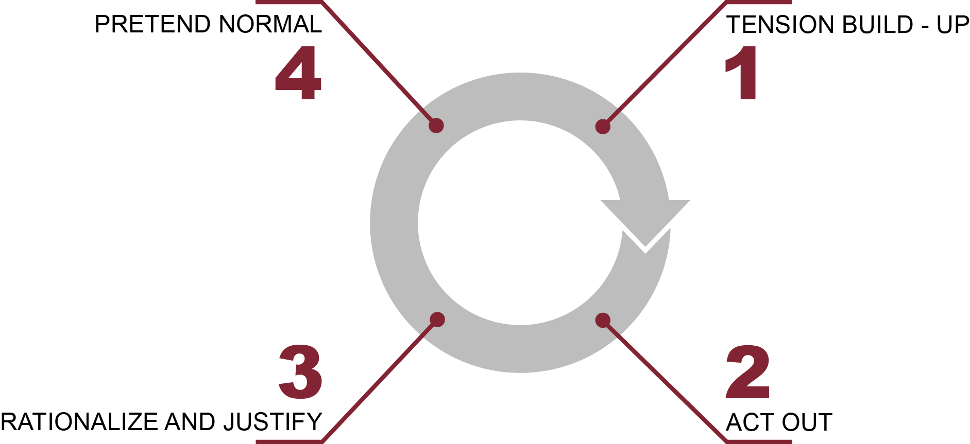
Cycle of violence
Phase 4:
Pretend normal
Phase 1:
Tension build-up
Phase 3:
Rationalize and justify
Phase 2:
Act out
3 / 5

Slide 4
TIPS FOR Healthy breakups:
Be honest. Break up in a way that respects the other person. Clearly state that the relationship is over, and try to explain why. Understand that the other person is likely to be hurt and may even feel angry.
Do not use social media to publicly humiliate someone to end a relationship.
It is okay to feel angry and hurt, but do not act out in anger. Do not take steps to retaliate or find ways to hurt that person. Do not use violence.
4 / 5

Slide 5
TIPS FOR Healthy breakups:
Try to remember that breakups can have a positive side. You can learn about yourself and possibly more about what you want from relationships in the future.
Talk to a friend about your feelings, and remember that it is okay to cry.
Keep busy. You may have more free time than you did before. Make plans to meet up with friends or family, or start a new hobby.
5 / 5

Slide 6
LOOK
LISTEN
LINK
LIVE
1 / 5
Notes:
Copyright © 2020 The Canadian Red Cross Society

Slide 7
STEP 1: LOOK
Sad
Angry
Taking big risks
Hurting themselves or others
Using drugs and alcohol
Anxious
Alone
2 / 5
Notes:
Copyright © 2020 The Canadian Red Cross Society
LOOK: Are they acting different than before? Are they: sad, anxious, angry, and alone all the time, drinking and using drugs, taking big risks, hurting themselves or others.
We need to be looking out for each other and checking in with teammates and friends.

Slide 8
STEP 2: LISTEN
Are you okay?
Can I help?
Be calm
Be open
Listen without judgment
3 / 5
Notes:
Copyright © 2020 The Canadian Red Cross Society
LOOK: Are they acting different than before? Are they: sad, anxious, angry, and alone all the time, drinking and using drugs, taking big risks, hurting themselves or others.
We need to be looking out for each other and checking in with teammates and friends.

Slide 9
STEP 3: LINK
Cadet / JCR Leaders
Parents / Caregivers
Counsellors / Teachers
Friends
Kids Help Phone
4 / 5
Notes:
Then we need to link them to people and/or resources.
LINK: Let them know there are people who can help. Encourage them to talk to a trusted adult or offer to go with them to talk to someone who can help. Let them know, “I want you to be safe; we need to get help.”
Copyright © 2020 The Canadian Red Cross Society
LOOK: Are they acting different than before? Are they: sad, anxious, angry, and alone all the time, drinking and using drugs, taking big risks, hurting themselves or others.
We need to be looking out for each other and checking in with teammates and friends.

Slide 10
STEP 4: LIVE
Journal
Sports / Exercise
Eat healthy
Music
Bead /
Sew /
Draw / Poetry
Time with animals
Hunt / Hike / Nature
Video / Movie theatre
Socialize
Talk to family and friends
5 / 5
Notes:
We want to ensure you are using healthy coping mechanism to deal with your stress.
What are some healthy ways to deal with stress? Have the players brainstorm a list then read out the ones on the PP.
Copyright © 2020 The Canadian Red Cross Society
LOOK: Are they acting different than before? Are they: sad, anxious, angry, and alone all the time, drinking and using drugs, taking big risks, hurting themselves or others.
We need to be looking out for each other and checking in with teammates and friends.

Slide 11
KIDS HELP PHONE
If you need one-on-one time with someone who gets what is going on in your life, you can connect anonymously with Kids Help Phone. Our counsellors are available 24 hours a day, seven days a week to support you with whatever you are going through.
CALL 1-800-668-6868 to talk with a counsellor
CHAT with a counsellor at KidsHelpPhone.ca or through the Always There App
TEXT 686868 to connect with a trained volunteer Crisis Responder
1 / 2

Slide 12
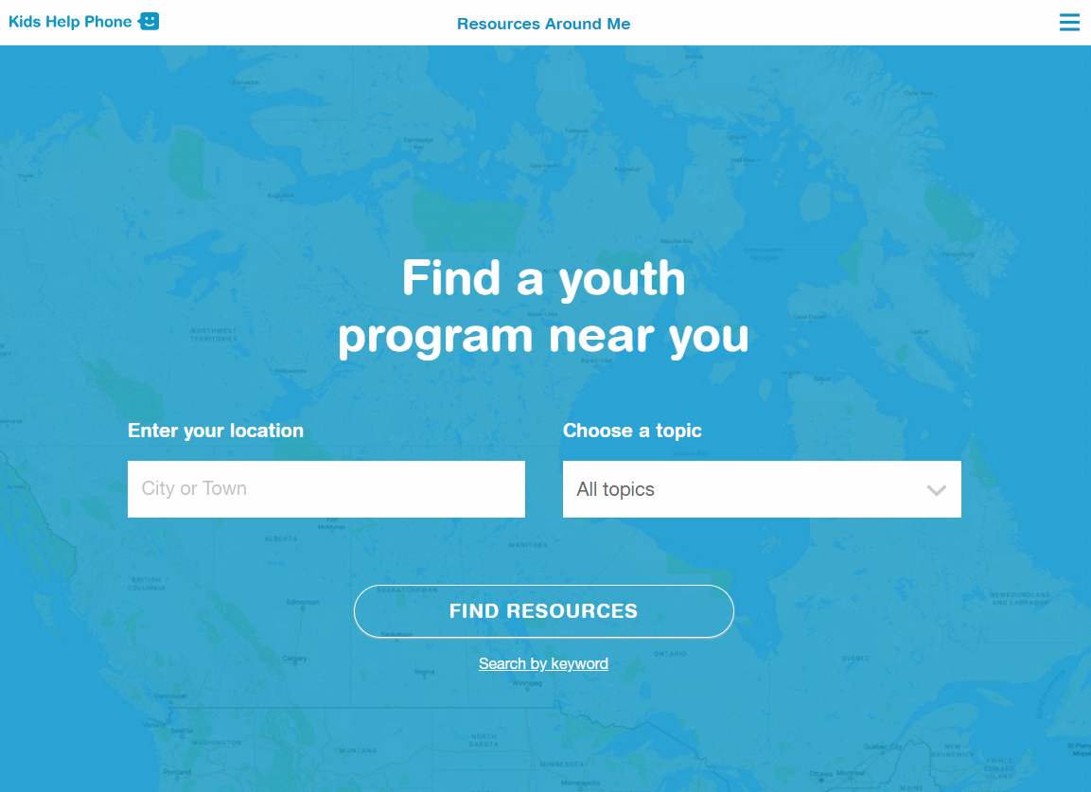
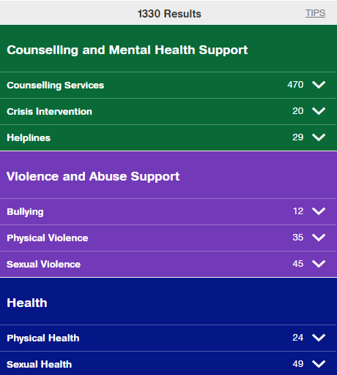
RESOURCES AROUND ME
Resources Around Me is a free, interactive tool, available in English and French, through Kids Help Phone’s website.
The tool helps young people to independently connect to local programs and services in their communities.
These services include:
Counseling and mental health
Sexual health
Housing help
Legal help
LGBTQ2S services
Youth shelters
kidshelpphone.ca/resourcesaroundme
2 / 2

Slide 13
Community Resources
Add local resources to this slide
1 / 1

