Slide 1
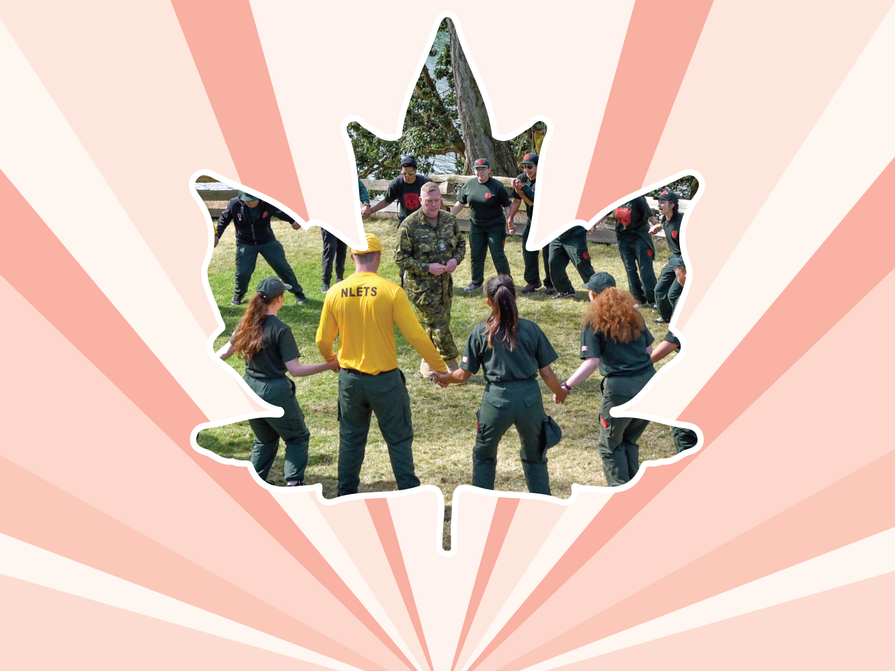
Lesson 4
Sexual orientation and
Gender identity
Ages 12–15

Slide 2
Sexual orientation
“Sexual orientation” refers to a
person’s feelings of sexual and
romantic attraction.
2 / 16
Notes:
Girl’s Best Friend Foundation and Advocates for Youth. (2005). Creating safe space for GLBTQ youth: A toolkit.

Slide 3
Gender identity
“Gender identity” is about how you feel about yourself as male, female, both, in between, or neither.
3 / 16
Notes:
Girl’s Best Friend Foundation and Advocates for Youth. (2005). Creating safe space for GLBTQ youth: A toolkit.

Slide 4
Types of Sexual orientation:
Heterosexual: A term used to describe a person who is emotionally, physically, or sexually attracted to someone of the opposite gender; also referred to as “straight”. E.g., a person who identifies as male is attracted to a person who identifies as female.
4 / 16
Notes:
Girl’s Best Friend Foundation and Advocates for Youth. (2005). Creating safe space for GLBTQ youth: A toolkit.

Slide 5
Types of Sexual orientation:
Lesbian: A term used to describe a female-identified person who is romantically and sexually attracted to other females.
Gay: A term used to describe a male-identified person who is romantically and sexually attracted to other males.
5 / 16
Notes:
Girl’s Best Friend Foundation and Advocates for Youth. (2005). Creating safe space for GLBTQ youth: A toolkit.

Slide 6
Types of Sexual orientation:
Bisexual: A term used to describe a person who is romantically and sexually attracted to more than one gender.
6 / 16
Notes:
Girl’s Best Friend Foundation and Advocates for Youth. (2005). Creating safe space for GLBTQ youth: A toolkit.

Slide 7
Types of Sexual orientation:
Pansexual: A term used to describe a person who is attracted to people for who they are as a person, regardless of their gender.
7 / 16
Notes:
Girl’s Best Friend Foundation and Advocates for Youth. (2005). Creating safe space for GLBTQ youth: A toolkit.

Slide 8
Types of Sexual orientation:
Asexual: A term used to describe a person who does not have feelings of sexual attraction for people of any gender.
8 / 16
Notes:
Girl’s Best Friend Foundation and Advocates for Youth. (2005). Creating safe space for GLBTQ youth: A toolkit.

Slide 9
TYPES OF
gender identity:
Transgender: A term used by people whose gender identity does not match up with their sex assigned at birth. E.g., they are born a male / boy but feel and identify as a female / girl.
9 / 16

Slide 10
TYPES OF
gender identity:
Cisgender: A term used to describe people whose gender identity matches their sex assigned at birth; e.g., a person who is born a male / boy and identifies as, and feels like, a male / boy throughout his life.
10 / 16

Slide 11
TYPES OF
gender identity:
Genderqueer: A term that refers to people who identify outside the conventional gender categories of male or female.
11 / 16

Slide 12
TYPES OF
gender identity:
Two-spirit (2S): A term used by some Indigenous people (First Nations, Inuit, or Métis) to describe individuals who have both a feminine and masculine spirit living in their body.
12 / 16

Slide 13
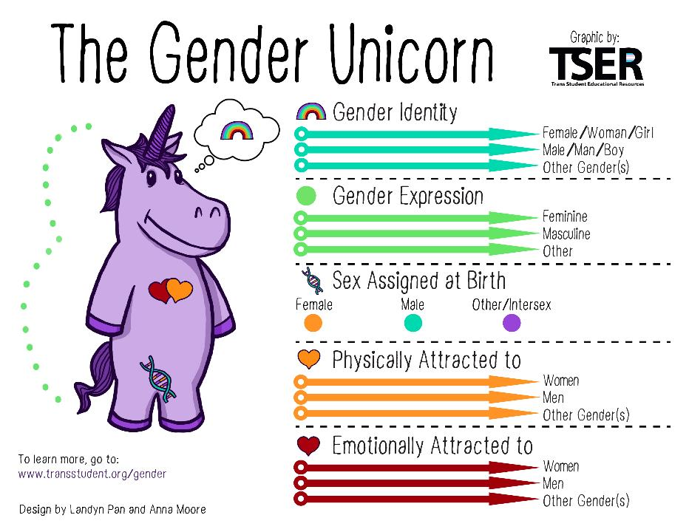
13 / 16

Slide 14
Homophobia and Transphobia
“Homophobia” is the fear or hatred of, aversion to, and discrimination against homosexuals or homosexual behaviour.
“Transphobia” is the fear, hatred, disbelief, or mistrust of people who are transgender, people who are thought to be transgender, or people whose gender expression does not conform to traditional gender roles.
14 / 16
Notes:
Girl’s Best Friend Foundation and Advocates for Youth. (2005). Creating safe space for GLBTQ youth: A toolkit.

Slide 15
WHAT IS an ally?
An “ally” is someone who supports and stands up for the rights and dignity of individuals and identity groups that are different from their own.
15 / 16
Notes:
Girl’s Best Friend Foundation and Advocates for Youth. (2005). Creating safe space for GLBTQ youth: A toolkit.

Slide 16
Gender expression
“Gender expression” is how a person expresses their gender identity on the outside.
16 / 16

Slide 17




LINK
LOOK
LISTEN
LIVE
1 / 5
Notes:
Copyright © 2020 The Canadian Red Cross Society
LOOK: Are they acting different than before? Are they: sad, anxious, angry, and alone all the time, drinking and using drugs, taking big risks, hurting themselves or others.
We need to be looking out for each other and checking in with teammates and friends.

Slide 18
STEP 1: LOOK
Sad
Angry
Taking big risks
Hurting themselves or others
Using drugs and alcohol
Anxious
Alone
2 / 5
Notes:
Copyright © 2020 The Canadian Red Cross Society
LOOK: Are they acting different than before? Are they: sad, anxious, angry, and alone all the time, drinking and using drugs, taking big risks, hurting themselves or others.
We need to be looking out for each other and checking in with teammates and friends.

Slide 19
STEP 2: LISTEN
Are you okay?
Can I help?
Be calm
Be open
Listen without judgment
3 / 5
Notes:
Copyright © 2020 The Canadian Red Cross Society
LOOK: Are they acting different than before? Are they: sad, anxious, angry, and alone all the time, drinking and using drugs, taking big risks, hurting themselves or others.
We need to be looking out for each other and checking in with teammates and friends.

Slide 20
STEP 3: LINK
Cadet / JCR Leaders
Parents / Caregivers
Counsellors /
Teachers
Friends
Kids Help Phone
4 / 5
Notes:
Then we need to link them to people and/or resources.
LINK: Let them know there are people who can help. Encourage them to talk to a trusted adult or offer to go with them to talk to someone who can help. Let them know, “I want you to be safe; we need to get help.”
Copyright © 2020 The Canadian Red Cross Society
LOOK: Are they acting different than before? Are they: sad, anxious, angry, and alone all the time, drinking and using drugs, taking big risks, hurting themselves or others.
We need to be looking out for each other and checking in with teammates and friends.

Slide 21
STEP 4: LIVE
Journal
Sports / Exercise
Eat healthy
Music
Bead /
Sew /
Draw / Poetry
Time with animals
Hunt / Hike / Nature
Video / Movie theatre
Socialize
Talk to family and friends
5 / 5
Notes:
We want to ensure you are using healthy coping mechanism to deal with your stress.
What are some healthy ways to deal with stress? Have the players brainstorm a list then read out the ones on the PP.
Copyright © 2020 The Canadian Red Cross Society
LOOK: Are they acting different than before? Are they: sad, anxious, angry, and alone all the time, drinking and using drugs, taking big risks, hurting themselves or others.
We need to be looking out for each other and checking in with teammates and friends.

Slide 22





KIDS HELP PHONE
If you need one-on-one time with someone who gets what is going on in your life, you can connect anonymously with Kids Help Phone. Our counsellors are available 24 hours a day, seven days a week to support you with whatever you are going through.
CALL 1-800-668-6868 to talk with a counsellor
CHAT with a counsellor at KidsHelpPhone.ca or through the Always There App
TEXT 686868 to connect with a trained volunteer Crisis Responder
1 / 2

Slide 23
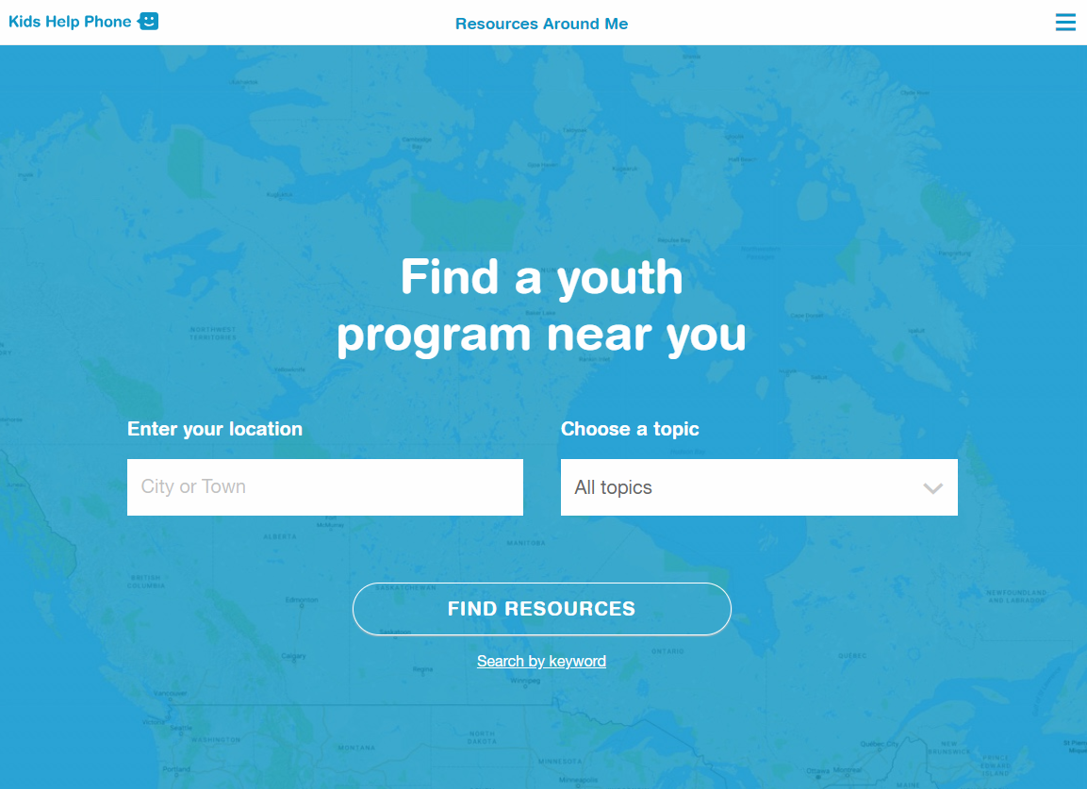
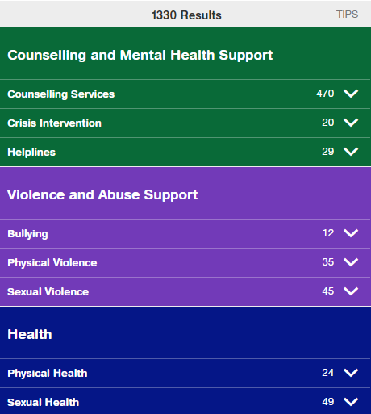
RESOURCES AROUND ME
Resources Around Me is a free, interactive tool, available in English and French, through Kids Help Phone’s website.
The tool helps young people to independently connect to local programs and services in their communities.
These services include:
  Counseling and mental health
  Sexual health
  Housing help
  Legal help
  LGBTQ2S services
  Youth shelters
kidshelpphone.ca/resourcesaroundme
2 / 2

Slide 24
Community Resources
Add local resources to this slide
1 / 1

