Slide 1
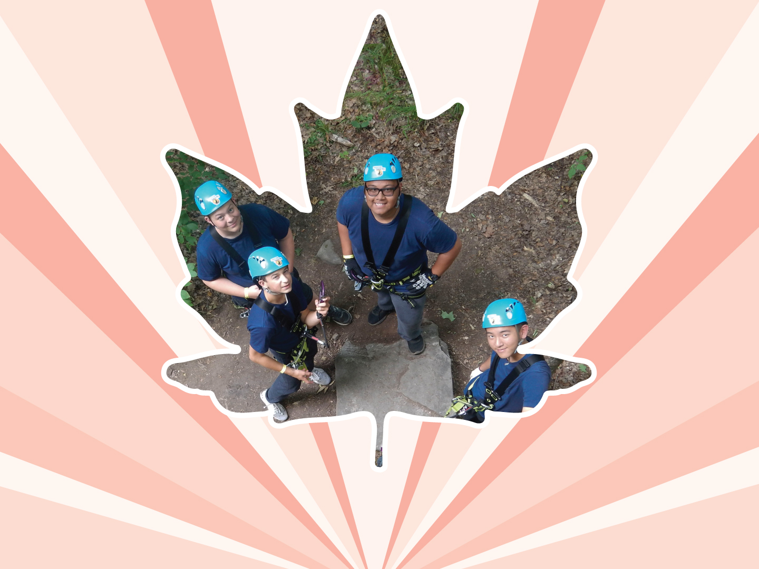
Lesson 1
Healthy Relationships
Ages 12–15

Slide 2
Characteristics of a Healthy Relationship
Respect
Trust
Healthy communication
Conflict resolution
Independence
Fun
Supportive
Equality
Safe
Empathy
Respecting personal boundaries
2 / 3
Notes:
Canadian Red Cross. (1997). Hearing the hurt, changing the future: Abuse prevention services for youth.

Slide 3
Ways to Resist Peer Pressure
Say “no” and let the person know you mean it.
Stand up straight, and make eye contact.
Say how you feel.
Do not make excuses.
Stick up for yourself.
Walk away from the situation.
Find something else to do with other friends.
Hang out with friends who will speak up and support you in resisting peer pressure.
3 / 3

Slide 4
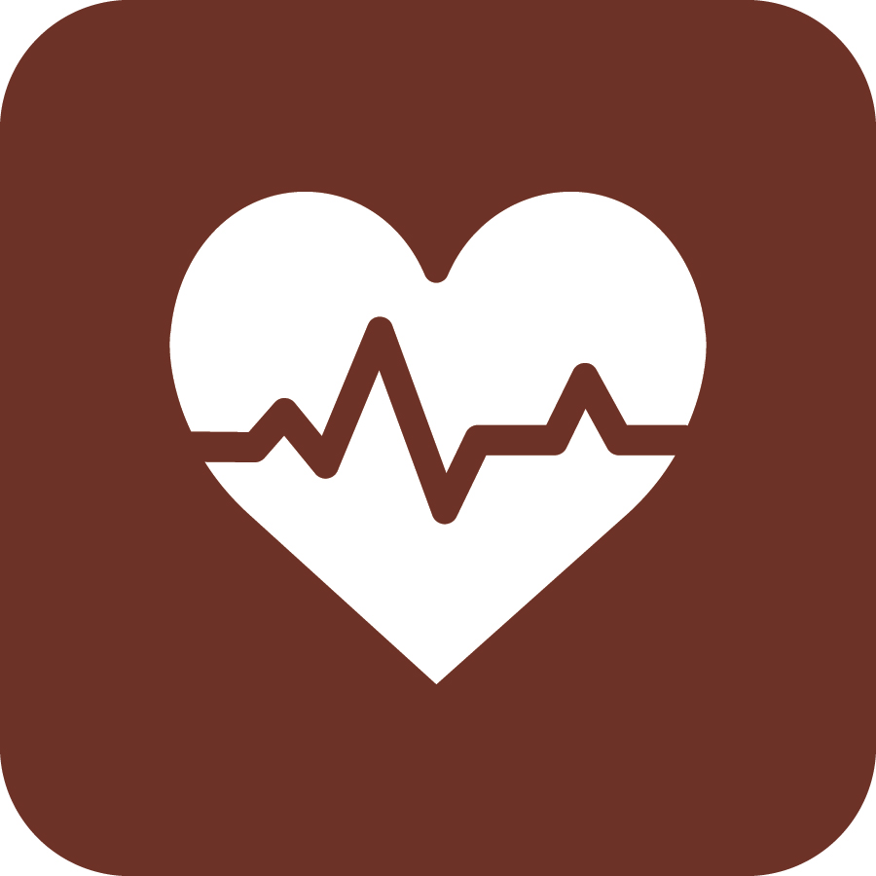
LOOK
LISTEN
LINK
LIVE
1 / 5
Notes:
Copyright © 2020 The Canadian Red Cross Society

Slide 5
STEP 1: LOOK
Sad
Angry
Taking big risks
Hurting themselves or others
Using drugs and alcohol
Anxious
Alone
2 / 5
Notes:
Copyright © 2020 The Canadian Red Cross Society
LOOK: Are they acting different than before? Are they: sad, anxious, angry, and alone all the time, drinking and using drugs, taking big risks, hurting themselves or others.
We need to be looking out for each other and checking in with teammates and friends.

Slide 6
STEP 2: LISTEN
Are you okay?
Can I help?
Be calm
Be open
Listen without judgment
3 / 5
Notes:
Copyright © 2020 The Canadian Red Cross Society
LOOK: Are they acting different than before? Are they: sad, anxious, angry, and alone all the time, drinking and using drugs, taking big risks, hurting themselves or others.
We need to be looking out for each other and checking in with teammates and friends.

Slide 7
STEP 3: LINK
Cadet / JCR Leaders
Parents / Caregivers
Counsellors / Teachers
Friends
Kids Help Phone
4 / 5
Notes:
Then we need to link them to people and/or resources.
LINK: Let them know there are people who can help. Encourage them to talk to a trusted adult or offer to go with them to talk to someone who can help. Let them know, “I want you to be safe; we need to get help.”
Copyright © 2020 The Canadian Red Cross Society
LOOK: Are they acting different than before? Are they: sad, anxious, angry, and alone all the time, drinking and using drugs, taking big risks, hurting themselves or others.
We need to be looking out for each other and checking in with teammates and friends.

Slide 8
STEP 4: LIVE
Journal
Sports / Exercise
Eat healthy
Music
Bead /
Sew /
Draw / Poetry
Time with animals
Hunt / Hike / Nature
Video / Movie theatre
Socialize
Talk to family and friends
5 / 5
Notes:
We want to ensure you are using healthy coping mechanism to deal with your stress.
What are some healthy ways to deal with stress? Have the players brainstorm a list then read out the ones on the PP.
Copyright © 2020 The Canadian Red Cross Society
LOOK: Are they acting different than before? Are they: sad, anxious, angry, and alone all the time, drinking and using drugs, taking big risks, hurting themselves or others.
We need to be looking out for each other and checking in with teammates and friends.

Slide 9
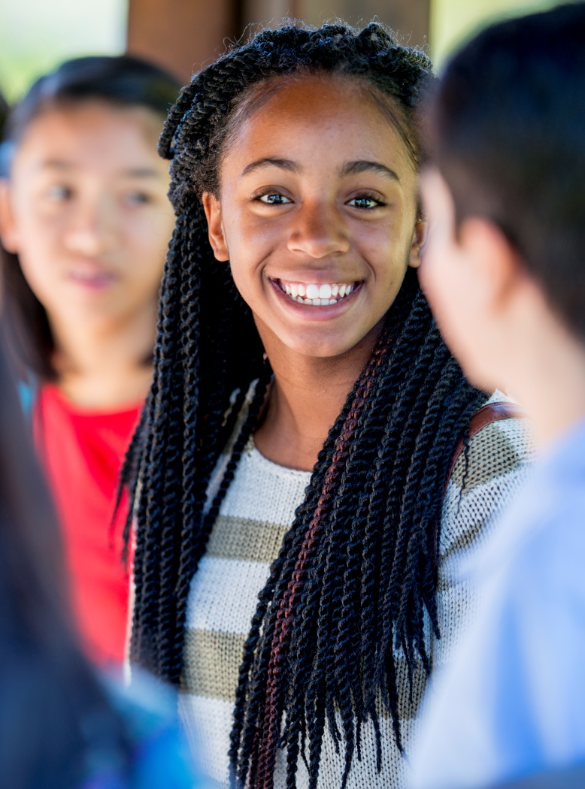
KIDS HELP PHONE
If you need one-on-one time with someone who gets what is going on in your life, you can connect anonymously with Kids Help Phone. Our counsellors are available 24 hours a day, seven days a week to support you with whatever you are going through.
CALL 1-800-668-6868 to talk with a counsellor
CHAT with a counsellor at KidsHelpPhone.ca or through the Always There App
TEXT 686868 to connect with a trained volunteer Crisis Responder
1 / 2

Slide 10
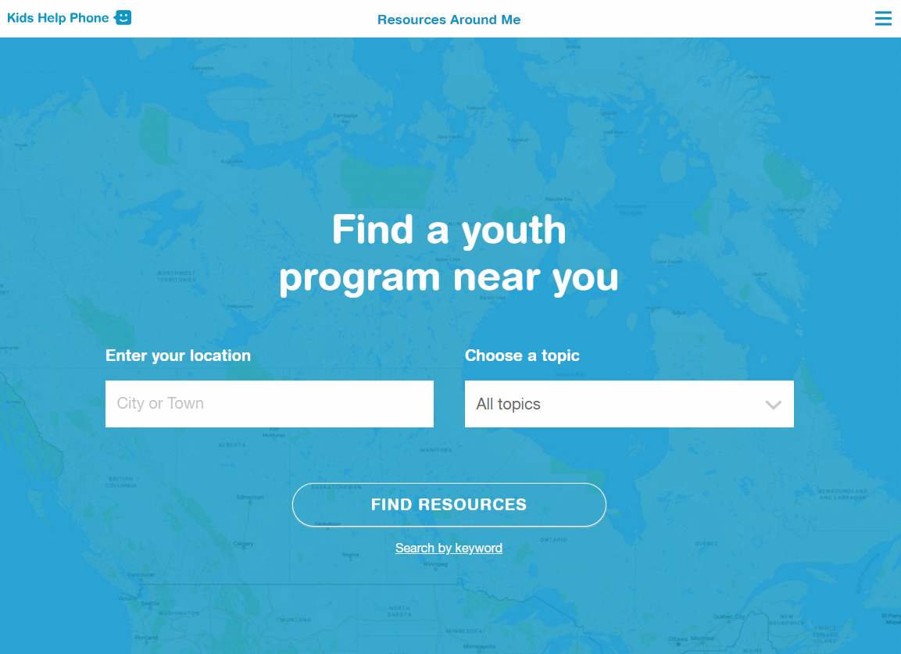
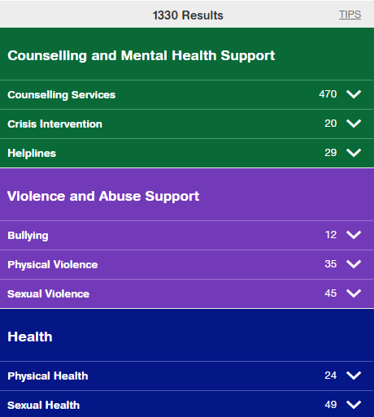
RESOURCES AROUND ME
Resources Around Me is a free, interactive tool, available in English and French, through Kids Help Phone’s website.
The tool helps young people to independently connect to local programs and services in their communities.
These services include:
Counseling and mental health
Sexual health
Housing help
Legal help
LGBTQ2S services
Youth shelters
kidshelpphone.ca/resourcesaroundme
2 / 2

Slide 11
Community Resources
Add local resources to this slide
1 / 1

